Slide 1
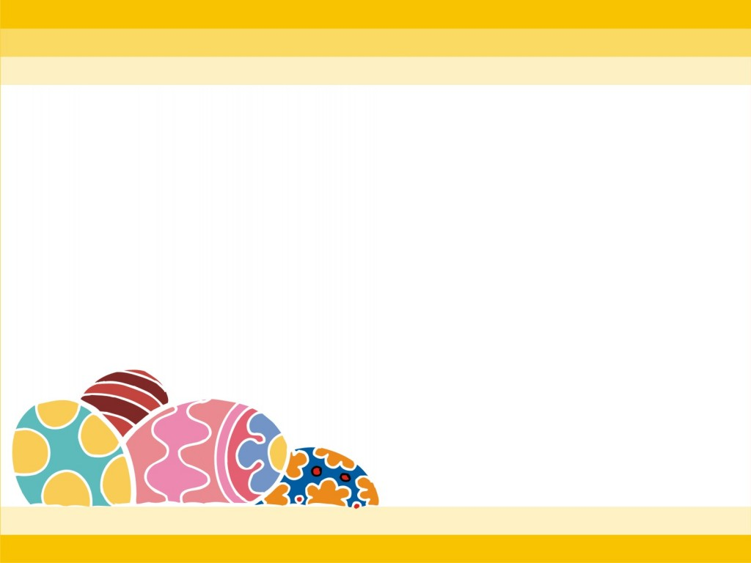


Warmly welcome to our class

Slide 2


WARM- UP

Slide 3











Slide 4
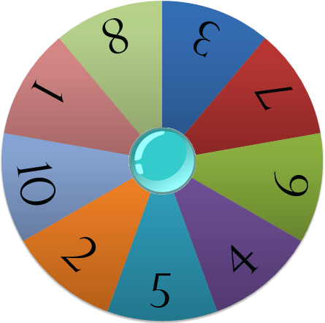
Lucky Wheel
RULES:
There are 6 numbers ( 5 questions and 1 Lucky number)
Choose the number & answer the question.
If the answer is right, the team will allow to spin the Wheel. If not, they will not allow to spin the Wheel.
The Team with the higher points is the Winner.
Play

Slide 5



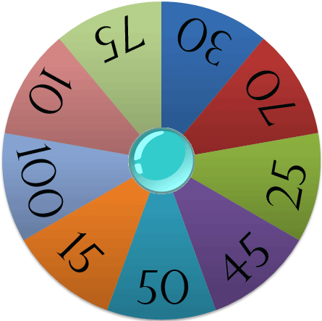




Choose a number
Spin
Points

Slide 6


04
03
01
00
02
05
10.00
A
B
11.50
C
10.15

Slide 7
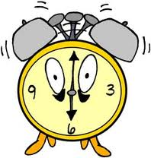

04
03
01
00
02
05
7.00
A
6.00
B
4.00
C

Slide 8
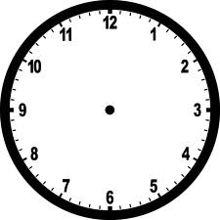
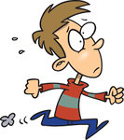
04
03
01
00
02
05
A
2.50
2. 45
B
1.45
C

Slide 9
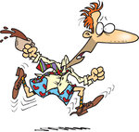
04
03
01
00
02
05
12:15
A
12:20
B
12:25
C

Slide 10
04
03
01
00
02
05
A
8:45
8:25
B
8:50
C

Slide 11
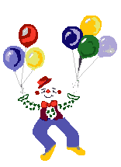






Slide 12

Tuesday, January 8th , 2018
Unit 11: What time is it?
Lesson2 : (1,2,3)

Slide 13
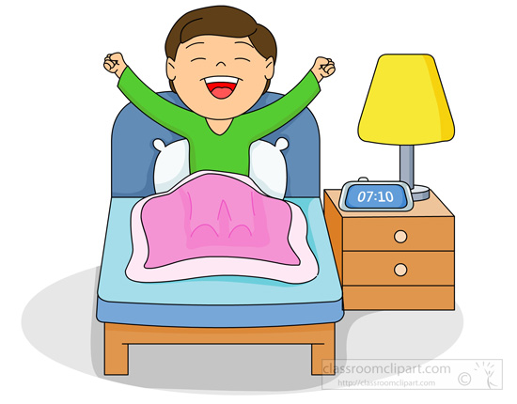

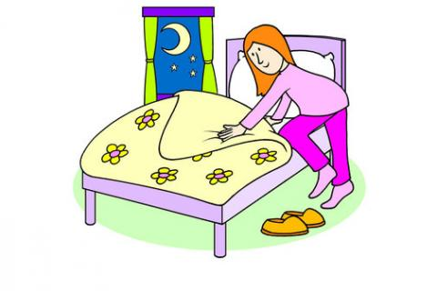
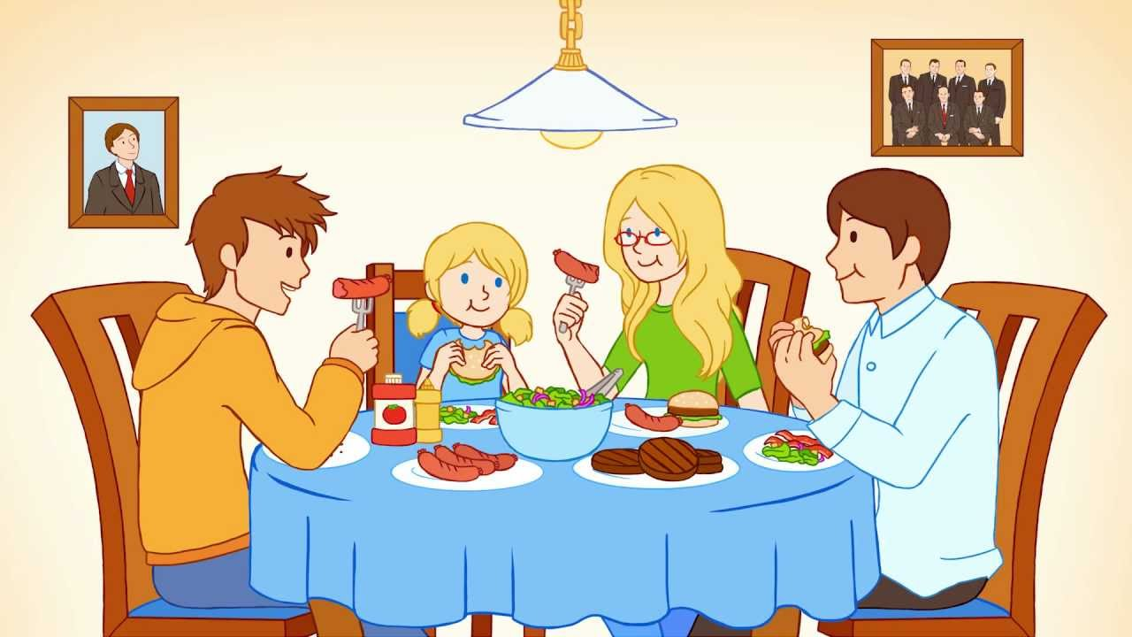
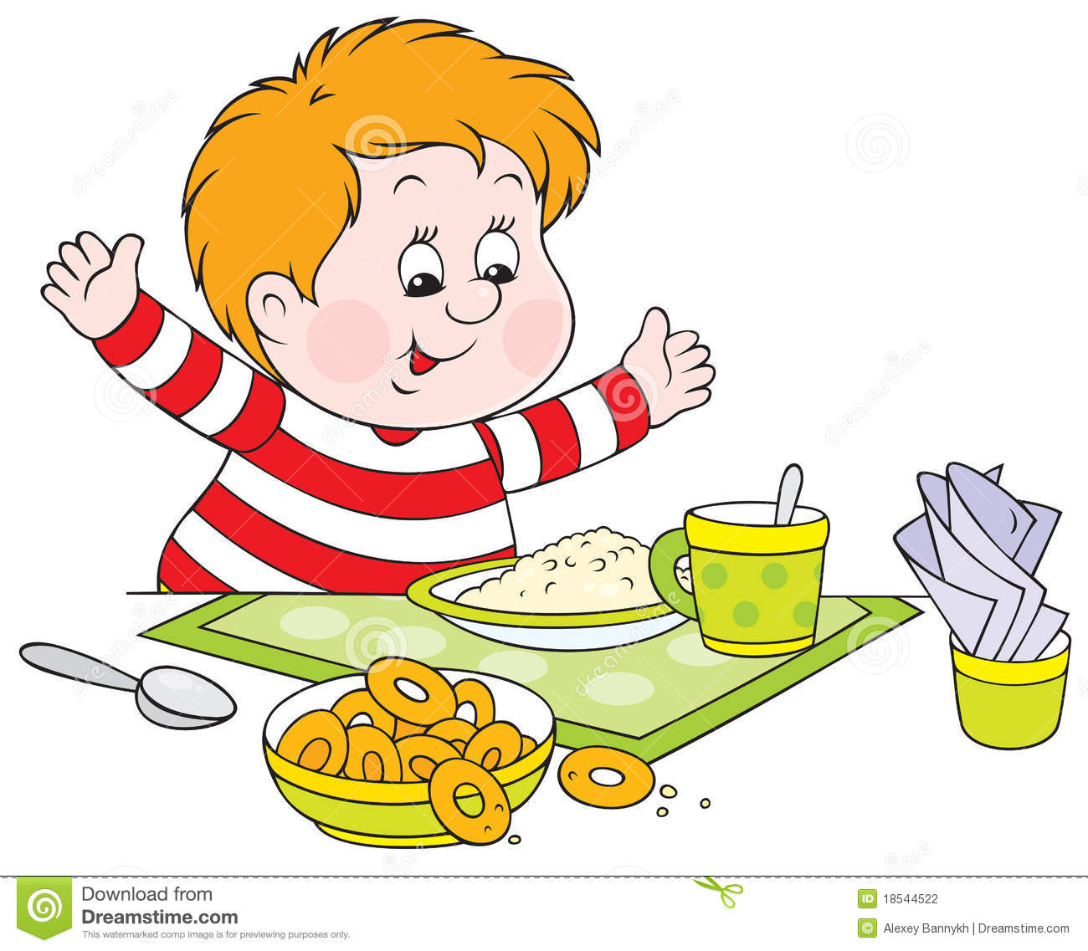
New Words
- Go to bed
- Have breakfast
- Go to school
- Have dinner
- Get up

Slide 14
Get up
Have breakfast
Have dinner
Go to School
Go to bed
Thức dậy
Ăn sáng
Ăn tối
Đến trường
Đi ngủ

Slide 15
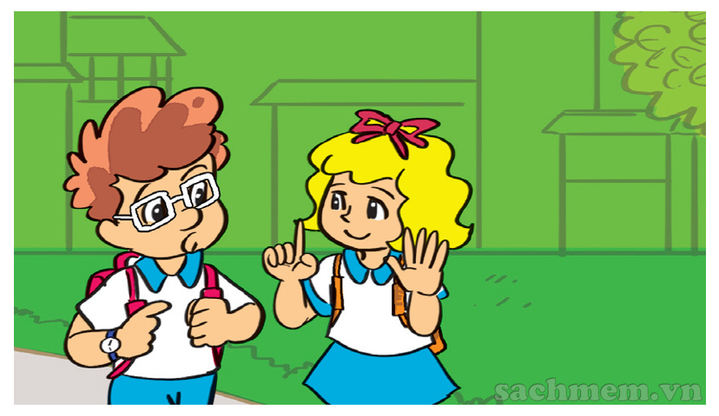
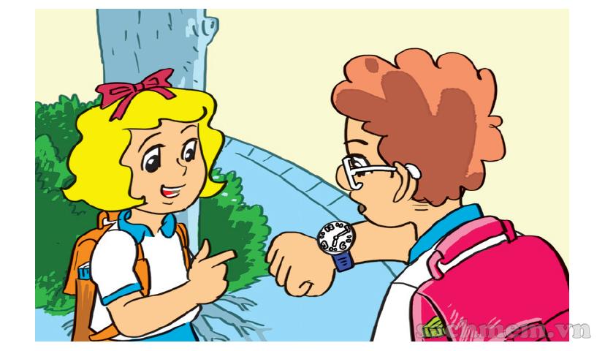
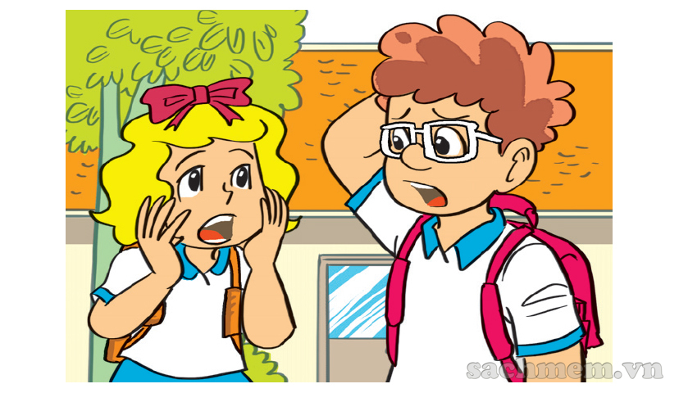

What time do you get up?
What time is it now?
a
a
Six o’clock.
Seven fifteen.
a
a
Let’s run.
Yes.
Oh no! We’re late for school.

Slide 16
*Structures:
Get up
What time do you …….......?
Get up
6 o’clock
I …………. At …….………

Slide 17

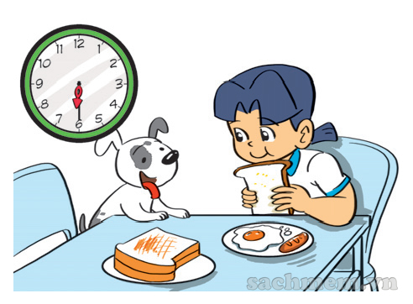
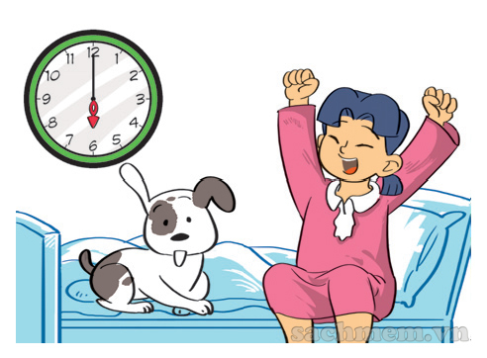
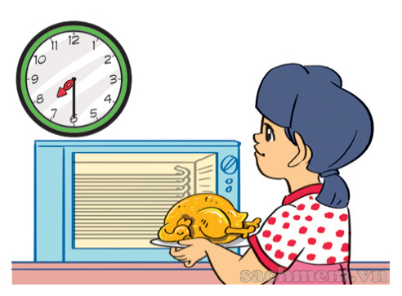
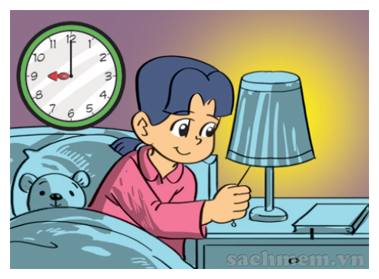

Slide 18
3. Let’s talk.
What time is it?
What time do you …………

Slide 19
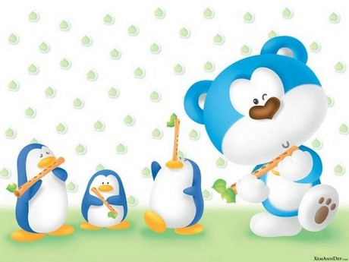
Tuesday, January 3rd, 2018
Unit 11: What time is it?
Lesson 2 : 4-5-6

Slide 20
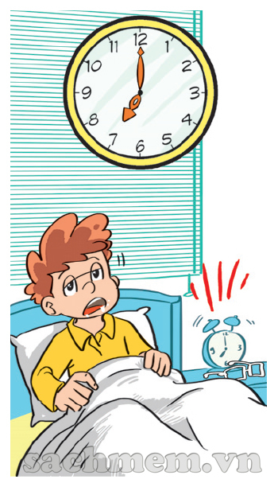
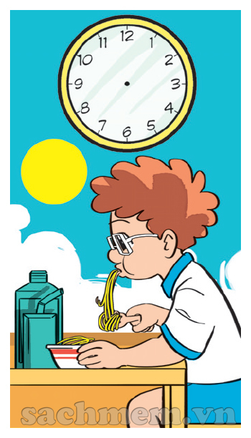

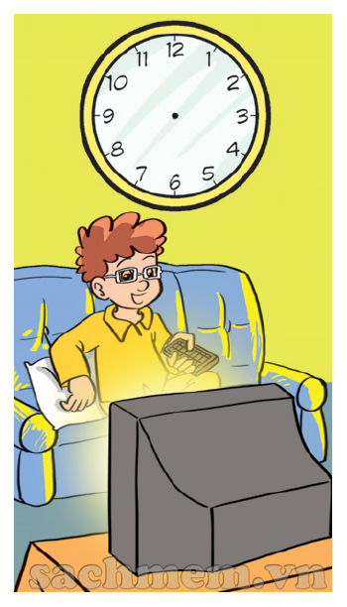
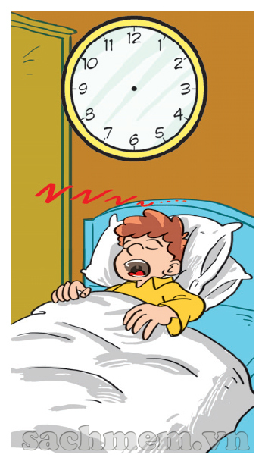
4. Listen and draw the time.
A
B
C
D
E

Slide 21
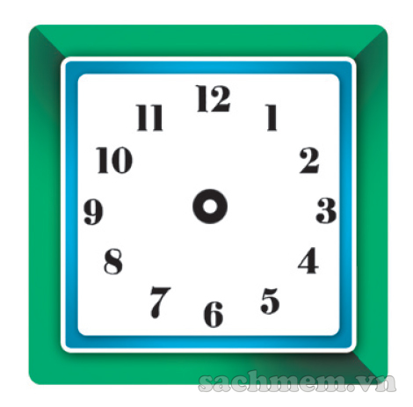
5. Draw and write the time.
What time do you get up?
I get up at ............
What time do you go to school?
...................
What time do you have dinner?
..................
What time do you go to bed?
...................

Slide 22
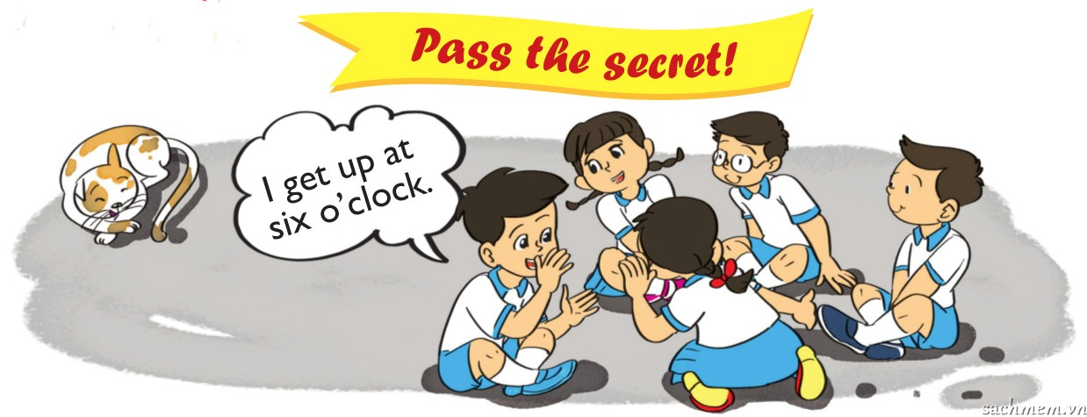
6. Let’s play

Slide 23




A
Goodbye
See you later.

